Slide 1
Recipt Invoice Digitizer
Prepared by : Rethika S - Team A
This is your space for legal copy. State whether the information is confidential and how it's intended to be used.
Company Name
Date

Slide 2
Contents
Company Name
Date
Project title
Slide 00
01
Why this?
Slide 00
02
My contribution
Slide 00
03
Sumamry
Slide 00
04

Slide 3
Project overview
Company Name
Date
A web-based application that allows users to upload receipts and invoices.
The system extracts and stores receipt information digitally.
Includes secure user authentication.
Designed to simplify expense tracking and document management.
Built using Python and Flask (Backend).

Slide 4
Project objectives
Company Name
Date
01
02
03
Eliminates manual entry of receipt details.
Prevents loss of physical bills.
Useful for individuals, freelancers, and businesses.

Slide 5
My Contribution:
Developed bcakend using Python Flask framework.
Uses JWT authentication for secure access.
Supports file upload functionality.
Technologies Used:
Python
Flask
JWT Authentication
Git & GitHub
Company Name
Date

Slide 6
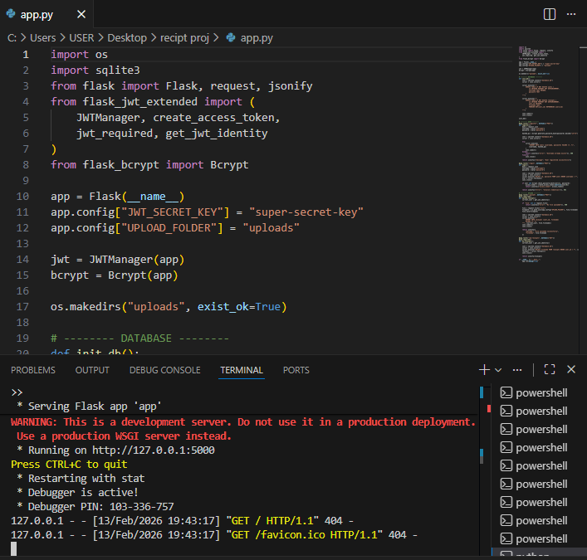
Python Code
Company Name
Date

Slide 7
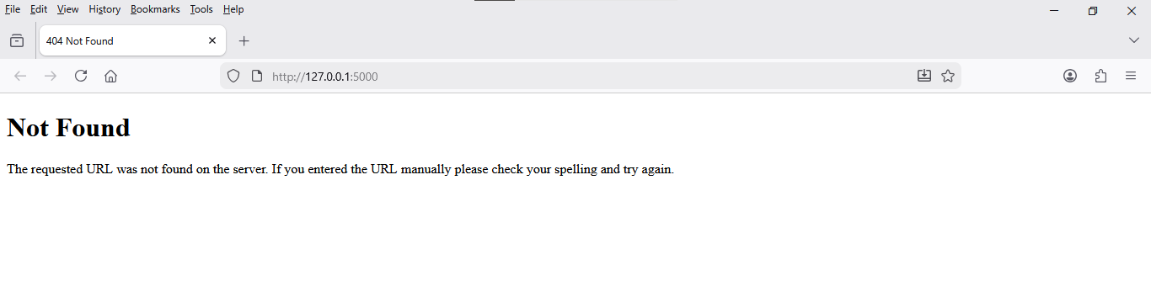
Output:
Company Name
Date

Slide 8
Program:
import os
import sqlite3
from flask import Flask, request, jsonify
from flask_jwt_extended import (
JWTManager, create_access_token,
jwt_required, get_jwt_identity
)
from flask_bcrypt import Bcrypt
app = Flask(__name__)
app.config["JWT_SECRET_KEY"] = "super-secret-key"
app.config["UPLOAD_FOLDER"] = "uploads"
jwt = JWTManager(app)
bcrypt = Bcrypt(app)
os.makedirs("uploads", exist_ok=True)
# -------- DATABASE --------
def init_db():
conn = sqlite3.connect("database.db")
cursor = conn.cursor()
cursor.execute("""
CREATE TABLE IF NOT EXISTS users (
id INTEGER PRIMARY KEY AUTOINCREMENT,
username TEXT UNIQUE,
password TEXT
)
Company Name
Date

Slide 9
Program:
i""")
cursor.execute("""
CREATE TABLE IF NOT EXISTS receipts (
id INTEGER PRIMARY KEY AUTOINCREMENT,
user_id INTEGER,
filename TEXT,
FOREIGN KEY(user_id) REFERENCES users(id)
)
""")
conn.commit()
conn.close()
init_db()
# -------- AUTH --------
@app.route("/register", methods=["POST"])
def register():
data = request.json
username = data["username"]
password = data["password"]
hashed_pw = bcrypt.generate_password_hash(password).decode("utf-8")
conn = sqlite3.connect("database.db")
cursor = conn.cursor()
Company Name
Date

Slide 10
Program:
itry:
cursor.execute(
"INSERT INTO users (username, password) VALUES (?, ?)",
(username, hashed_pw)
)
conn.commit()
except:
return jsonify({"error": "Username already exists"}), 400
finally:
conn.close()
return jsonify({"message": "User registered successfully"})
@app.route("/login", methods=["POST"])
def login():
data = request.json
username = data["username"]
password = data["password"]
conn = sqlite3.connect("database.db")
cursor = conn.cursor()
cursor.execute("SELECT id, password FROM users WHERE username = ?", (username,))
user = cursor.fetchone()
conn.close()
if user and bcrypt.check_password_hash(user[1], password):
access_token = create_access_token(identity=user[0])
Company Name
Date

Slide 11
Program:
i return jsonify({"access_token": access_token})
return jsonify({"error": "Invalid credentials"}), 401
# -------- UPLOAD --------
@app.route("/upload", methods=["POST"])
@jwt_required()
def upload_receipt():
current_user = get_jwt_identity()
if 'file' not in request.files:
return jsonify({"error": "No file uploaded"}), 400
file = request.files["file"]
filepath = os.path.join(app.config["UPLOAD_FOLDER"], file.filename)
file.save(filepath)
conn = sqlite3.connect("database.db")
cursor = conn.cursor()
cursor.execute("""
INSERT INTO receipts (user_id, filename)
VALUES (?, ?)
""", (current_user, file.filename))
conn.commit()
conn.close()
return jsonify({
"message": "File uploaded successfully",
Company Name
Date

Slide 12
Program:
i"filename": file.filename
})
@app.route("/my-receipts", methods=["GET"])
@jwt_required()
def my_receipts():
current_user = get_jwt_identity()
conn = sqlite3.connect("database.db")
cursor = conn.cursor()
cursor.execute("SELECT filename FROM receipts WHERE user_id = ?", (current_user,))
receipts = cursor.fetchall()
conn.close()
return jsonify(receipts)
if __name__ == "__main__":
app.run(debug=True)
Company Name
Date

Slide 13
Summary:
Company Name
Date
The Receipt & Invoice Digitizer automates receipt management.
Ensures secure user authentication and data storage.
Demonstrates backend development concepts.
Scalable system — OCR and frontend can be integrated.
Practical real-world application with future expansion potential.

